Slide 1
PUBLICITY DESIGN

Slide 2
WHAT IS PUBLICITY DESIGN?
Publicity is the act of attracting the attention of people and persuading them to buy any product.
It is a means of introducing new products to the market.
It is a propagation of certain things for sale.
Publicity is to make products/services public and introduce its benefits and qualities to the user.
It makes people aware of new things, products and services.
It also shapes an idea, habits and taste and convinces the buyer to buy products even before he meets the salesman.

Slide 3
Publicity can be done for
1. selling a product,
2. selling services,
3. selling the ideas.

Slide 4
TYPES OF PUBLICITY DESIGN
There are two main types.
Indoor Publicity
In indoor publicity print and electronic media play vital role like magazines, newspaper, advertisements on TV, Radio and Internet.
2. Outdoor Publicity
Through sign boards, banners, inscription on walls, posters.

Slide 5
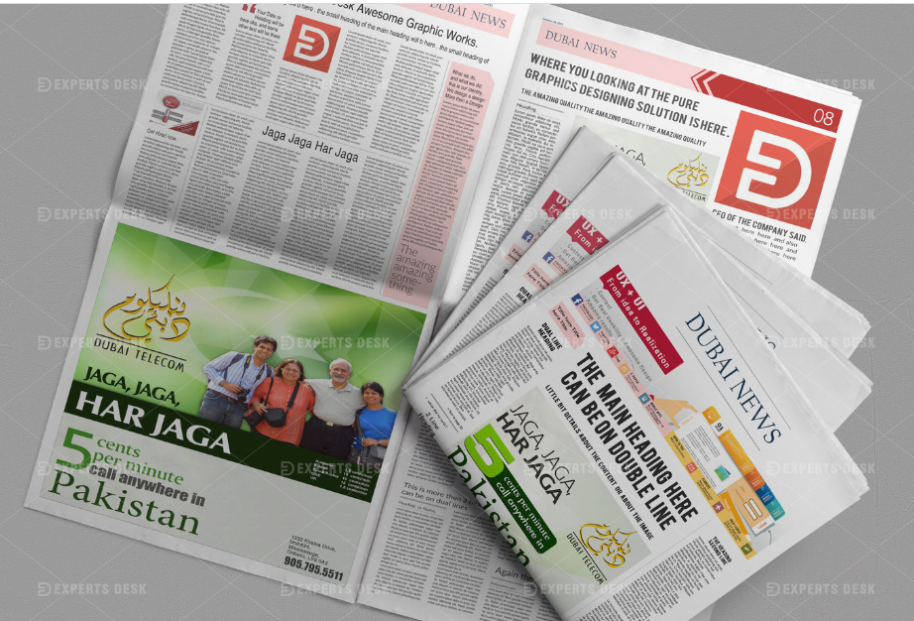
Outdoor Publicity
Indoor Publicity

Slide 6
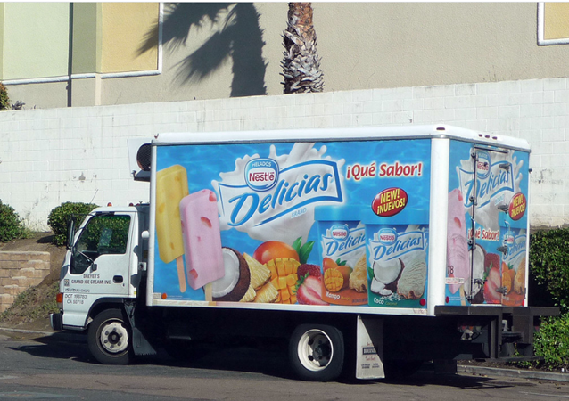
The other types of publicity design include:
3. Mobile/Transit Publicity:
Labeled vehicles like pick ups, daewoo buses, vehicles of different organizations and institutes, autos and cars are the source of mobile/transit publicity. Street hawkers are also the part of mobile publicity.

Slide 7
4. Complimentary Publicity:
Complimentary offers like buy 1 get 1 free, gift offers, prize winning offers for users, discount offers all are the tactics of complimentary publicity.

Slide 8
5. Large Scale Publicity:
Different campaigns and sponsored programs are also the part of publicity design.

Slide 9
Examples of promotional tactics for Publicity include:
Art exhibitions
Event sponsorship
Arrange a speech or talk
Make an analysis or prediction
Conduct a poll or survey
Issue a report
Take a stand on a controversial subject
Arrange for a testimonial
Announce an appointment
Present an award
Stage a debate
Organize a tour of your business or projects
Issue a commendation

Slide 10
Types of Promotional Selling
Selling is the basic purpose of publicity designs.
There are two types of selling keeping in view the target audience:
1. Hard Selling
2. Soft Selling
Magnetic Power / Magnetic Marketing

Slide 11
1. Hard Selling
Hard sell strategies are aggressive and usually put a high amount of pressure on the client. It gets straight to the point. This is especially important for clients who are ready to buy and aren’t looking around to do a few more meetings.

Slide 12
2. Soft Selling
Soft selling focuses on the relationship-building aspect of sales. You don’t put psychological pressure on potential buyers. Instead, you find passive ways to show them that you have the solutions they need.

Slide 13
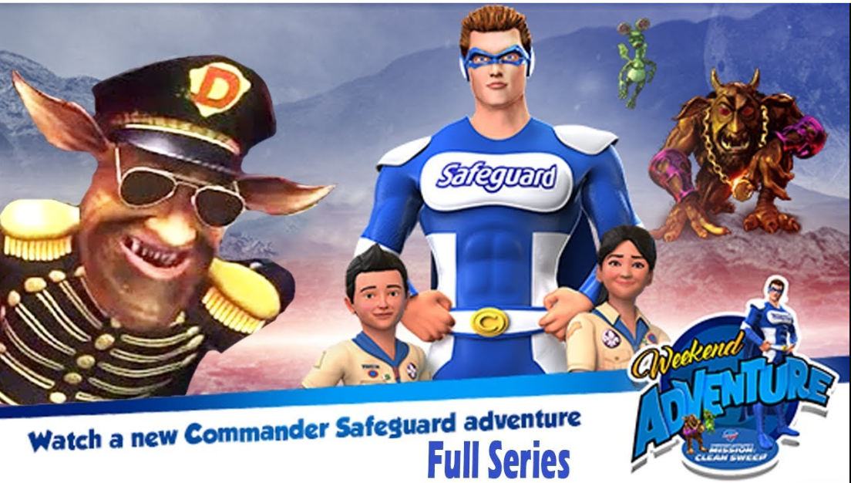
Magnetic Power / Magnetic Marketing
Magnetic marketing efforts, also known as attraction or sticky marketing efforts, don’t shout or push messages at potential customers. Instead, magnetic marketing “pulls” customers to your business like a magnet by using modern communication tools to provide them with engaging information they’re attracted to, actively searching for or value. The idea is that if you engage customers with content they value, they’re more likely to associate your business with memorable, positive experiences and remember you as an expert in your industry and a trusted resource. Those you’ve attracted are more likely to repeatedly shop at your business or provide positive reviews that attract others to it.

Slide 14
Indoor Publicity

Slide 15
Outdoor publicity

Slide 16
Outdoor Publicity

Slide 17
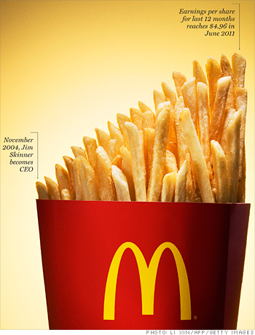
Complimentary Publicity

